Slide 1
Load, Preload and unload.
Milind Parab

Slide 2
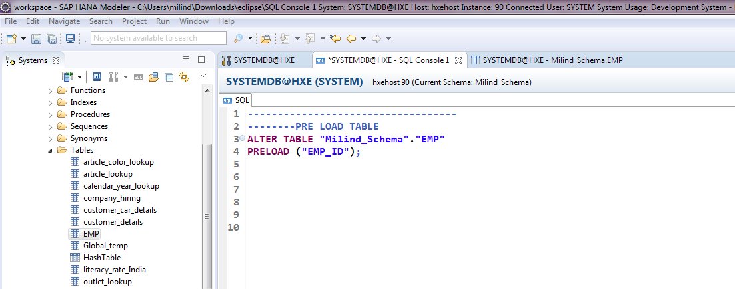
PRELOAD TABLE.

Slide 3
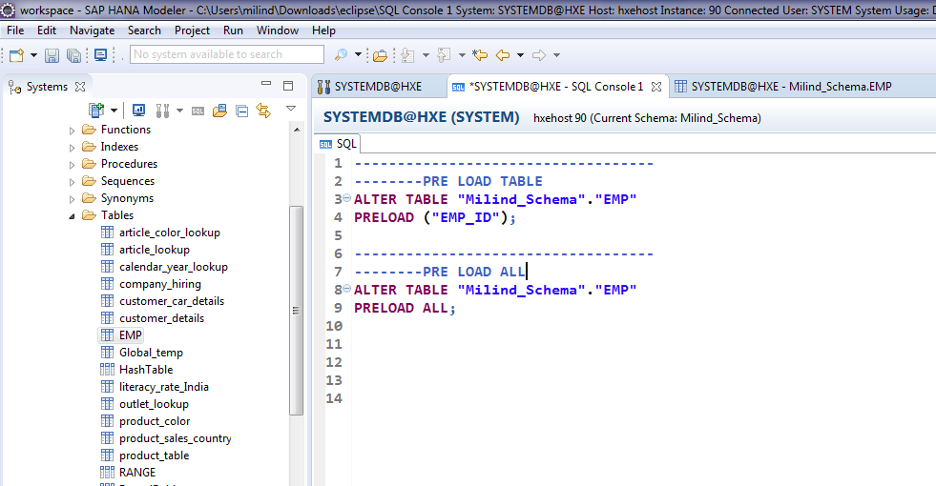
PRE LOAD ALL.

Slide 4
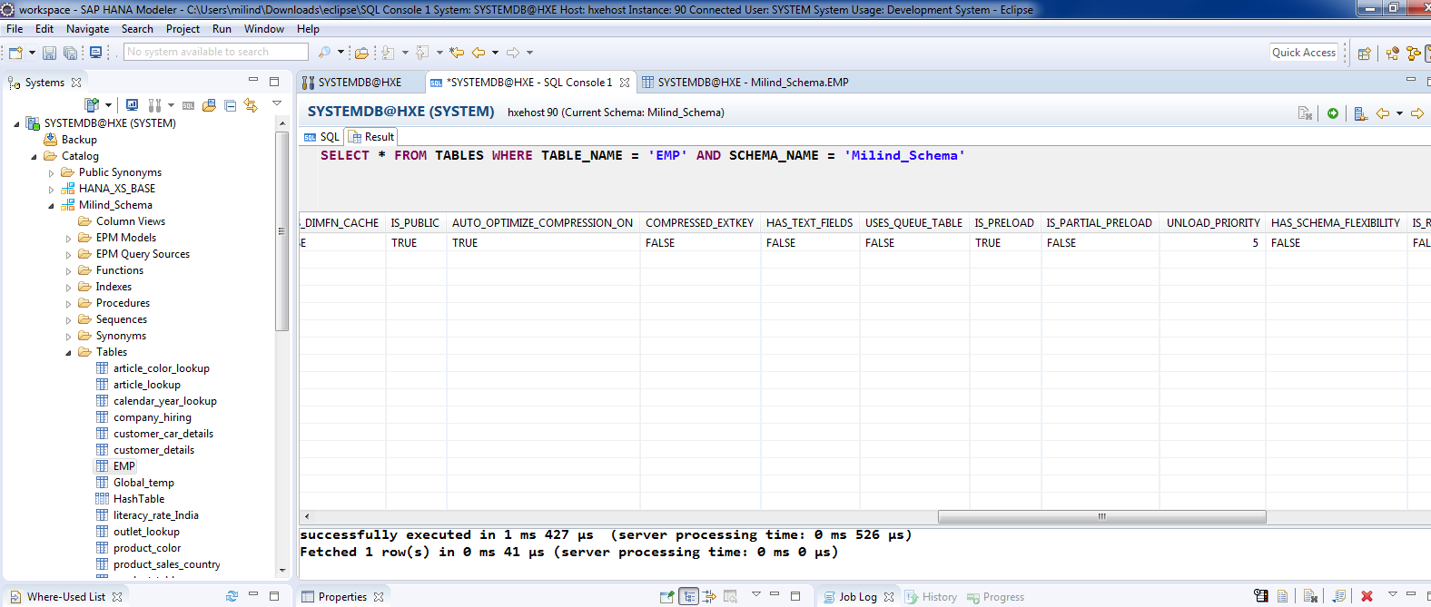
To see table configuration.

Slide 5
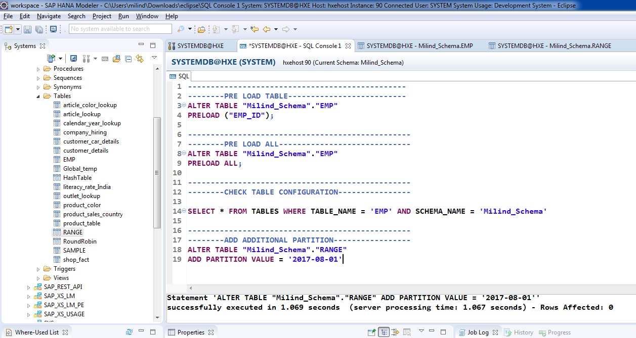
Add Partition.

Slide 6
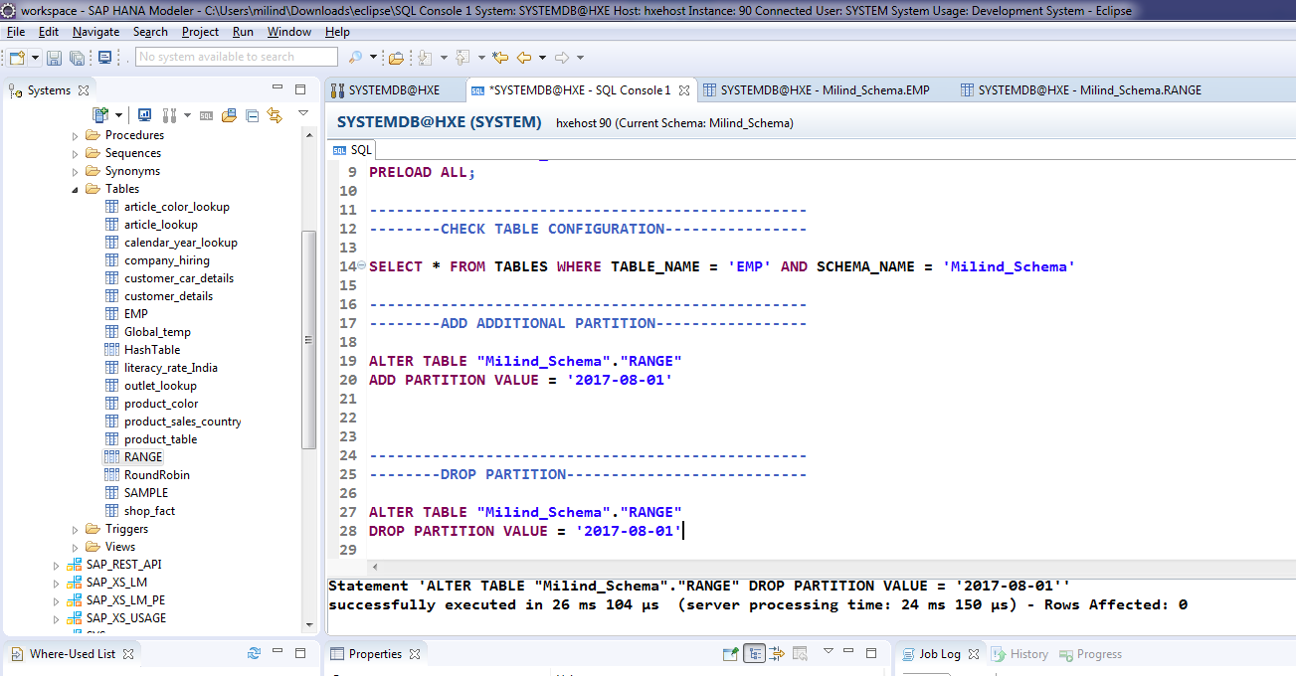
Drop Partition.

Slide 7
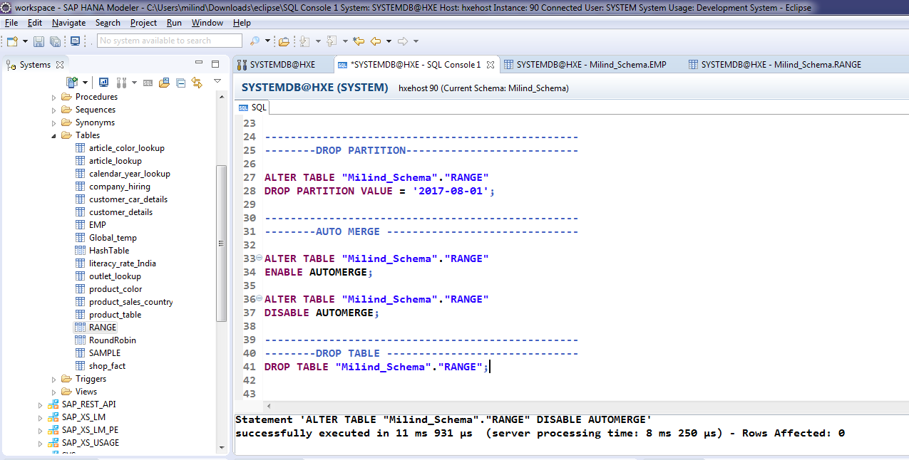
Auto Merge.

Slide 8
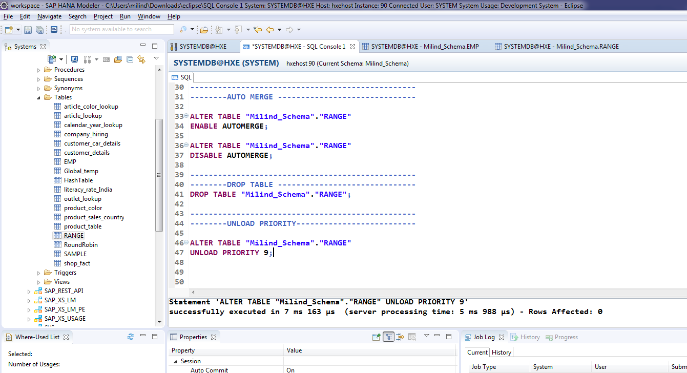
Set Unload Priority.

Slide 9
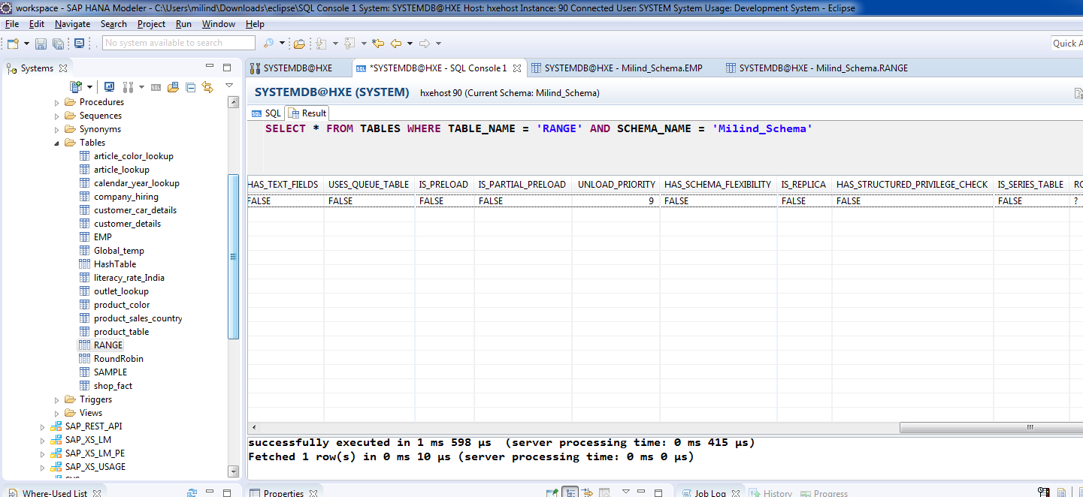
Cont.

